Slide 1
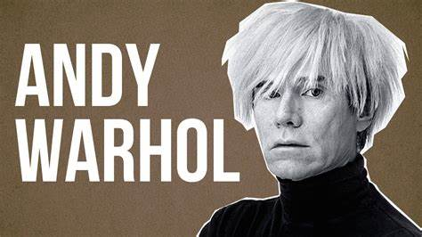
The Pope of the pop

Slide 2
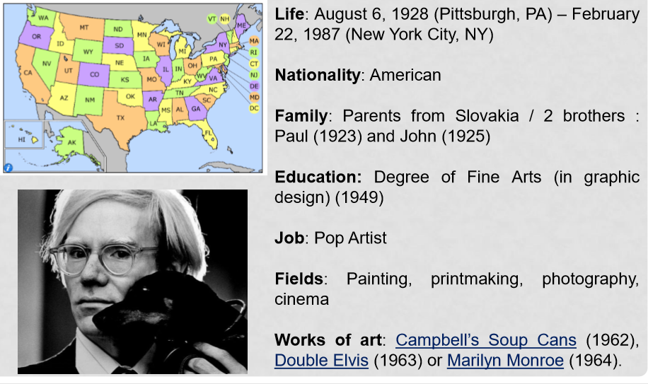

Slide 3
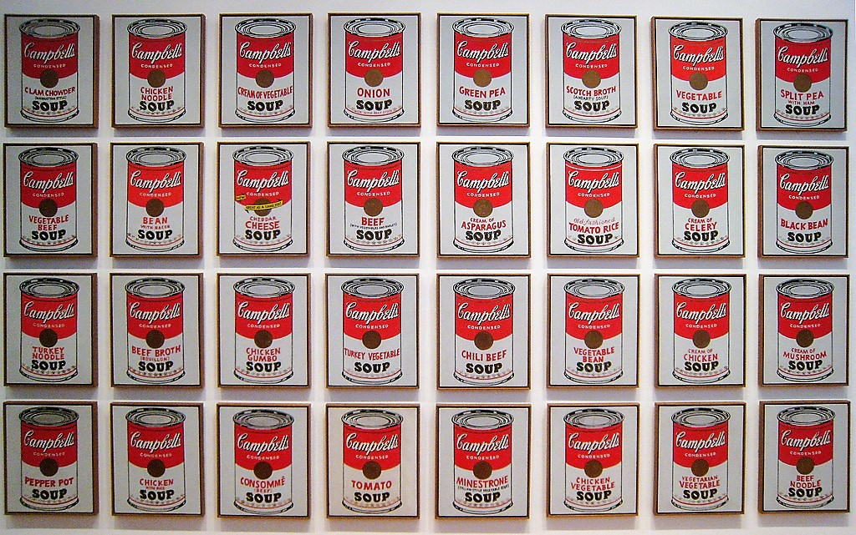
The pop art’s history by warhol
Pop art comes from the word « popular »
He tackled the consumer society
He elevated daily items to the rank of Art products

Slide 4
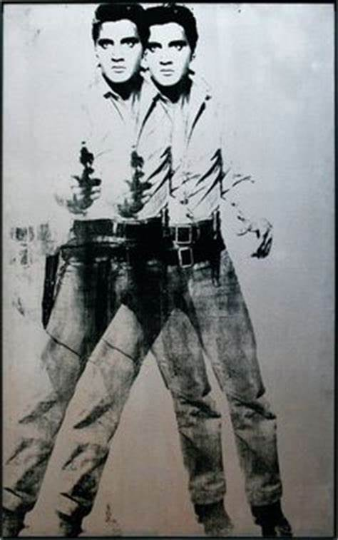
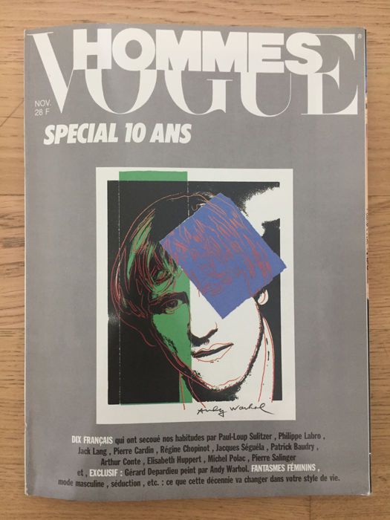
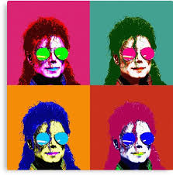
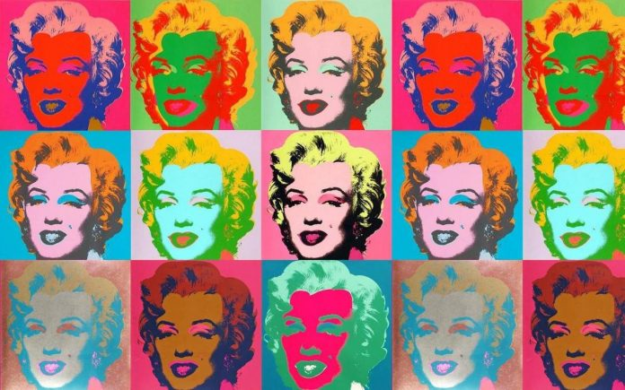
WELL-known works
He painted many famous people
He broke the dogmas of Art and Culture

Slide 5
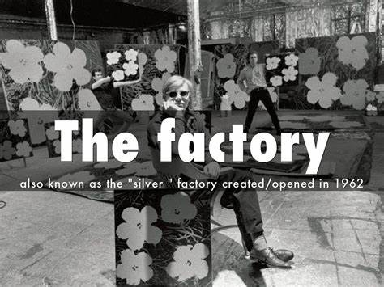
THE FACTORY
He created his own studio called “The Factory”
There, he made paintings, screen printings, photographs, drawings, sculptures and short films

Slide 6
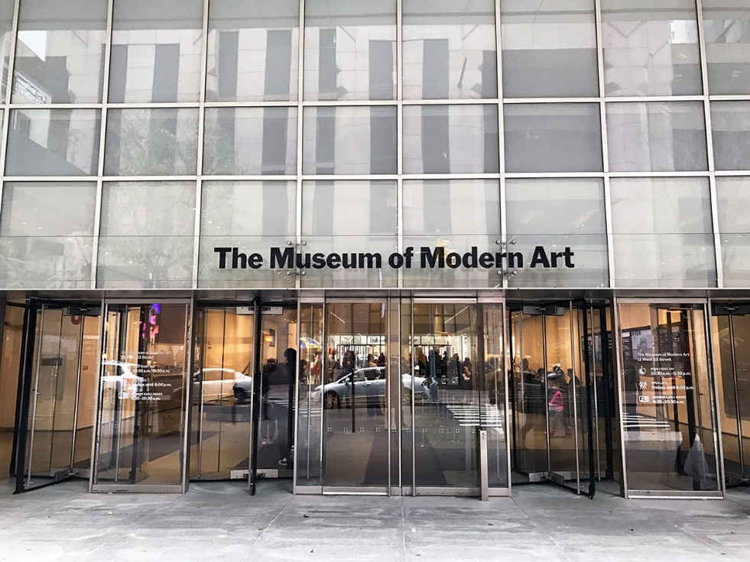
The MoMA in N.Y.

Slide 7
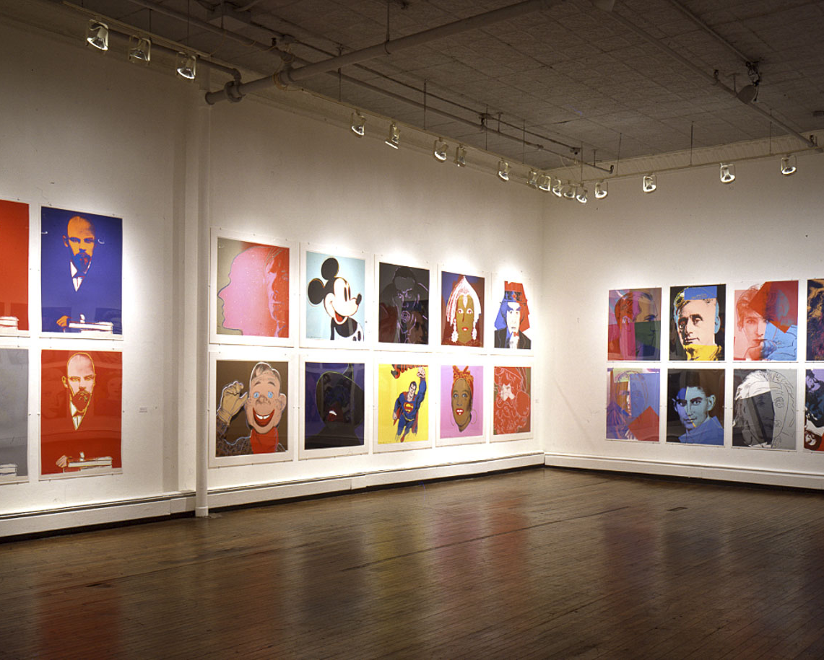
The Warhol Museum in Pittsburgh

Slide 8
